Slide 1
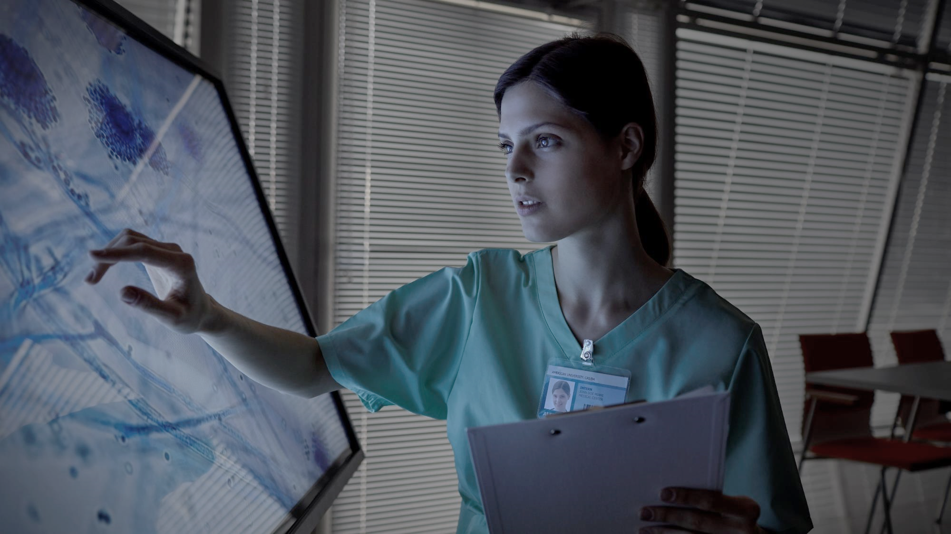
Philips Code to Care – AI FOR HEALTHCARE
THEME : Cancer (Lesion) Detection & Segmentation
Telepathology using Self- Improving AI
For efficient and accurate detection and segmentation of lesion, a self-improving Artificial Intelligence model is developed, which constantly improve as new data is obtained. To ensure access from remote locations, this model is deployed in a server, which ensures retrieval of results within few mouse clicks. Initially, to increase reliability, additional functionality of expert opinion in case of low confidence prediction from AI model is also incorporated.

Slide 2
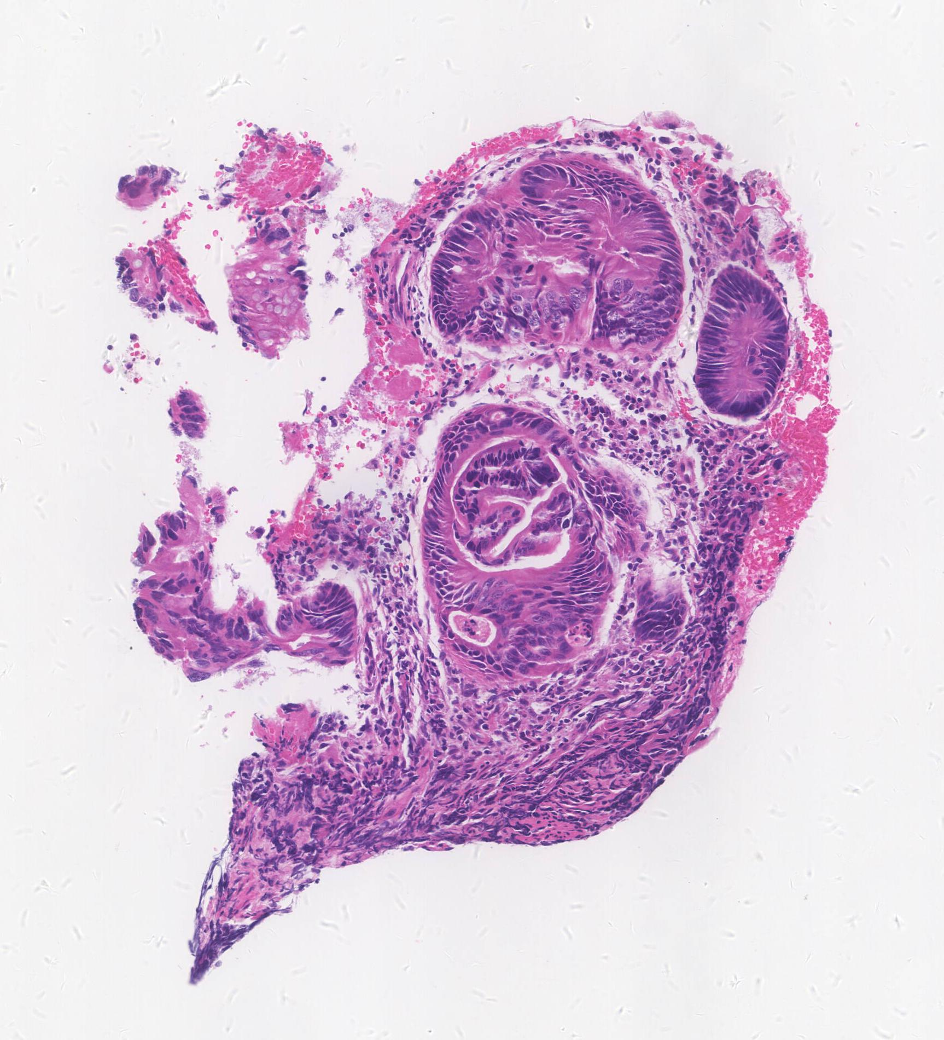
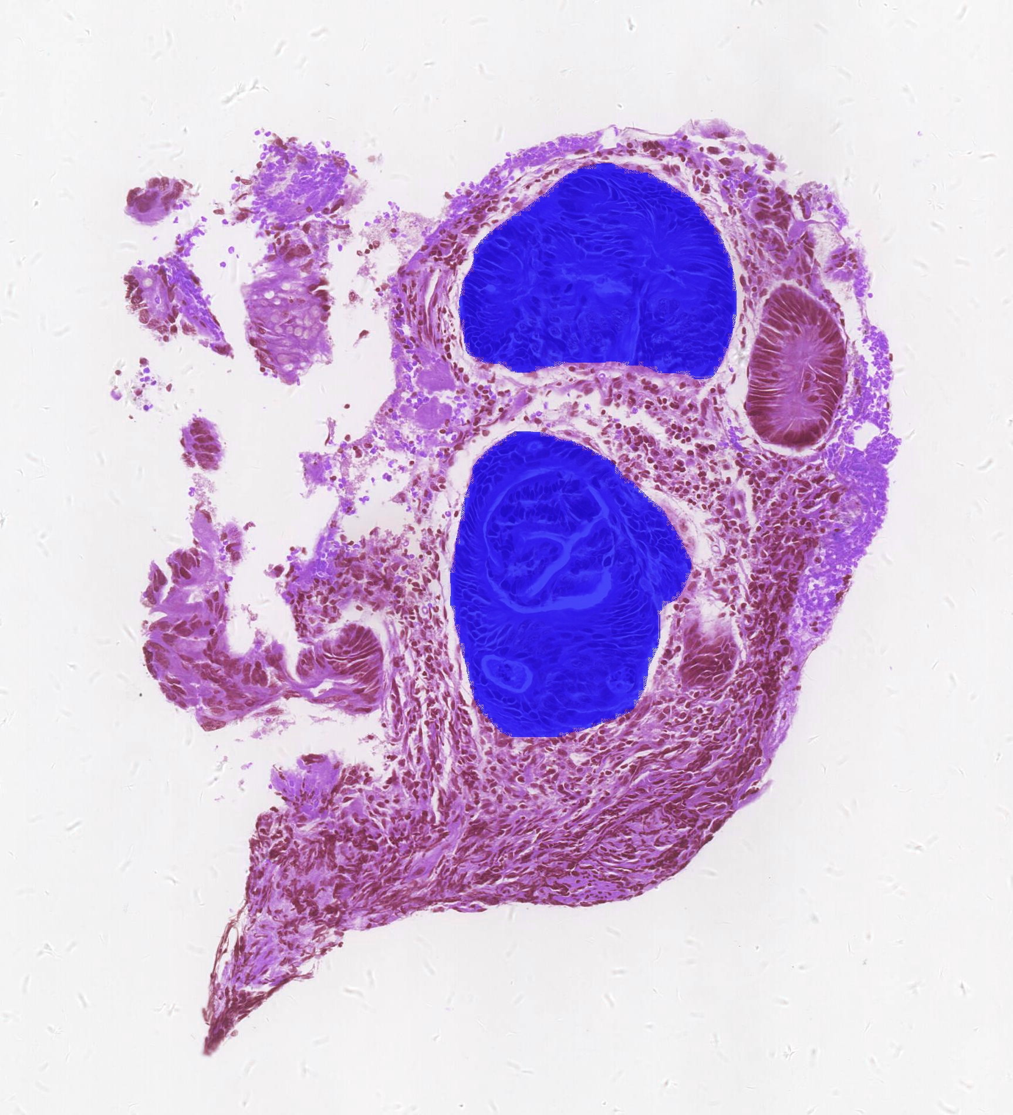
Telepathology using Self - Improving AI
Background
Telepathology
Telepathology is the practice of medical diagnosis facilitated by digital transmission to transfer image-rich pathology data between distant locations.
Lesion
Lesion is an abnormal area of tissue, which has an increased risk of developing into cancer. Early detection of such cells leads to significant improvement in patient survival rate.
Artificial Intelligence for Detecting Lesions
Automated detection & segmentation of lesions is accomplished from Whole Slide Images (WSI) using Deep Neural Networks.
Deep Neural Network
Sample Whole Slide Image
Segmented lesions (in blue)
Image Source : Self created

Slide 3

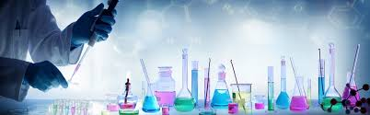
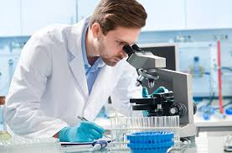
Conventional METHODOLOGY
send biopsy
forward to pathologist
Biopsy done from hospital
Processing of received tissues
Pathologist examine the tissues
Report sent to the hospital
Image Source : Google Images

Slide 4
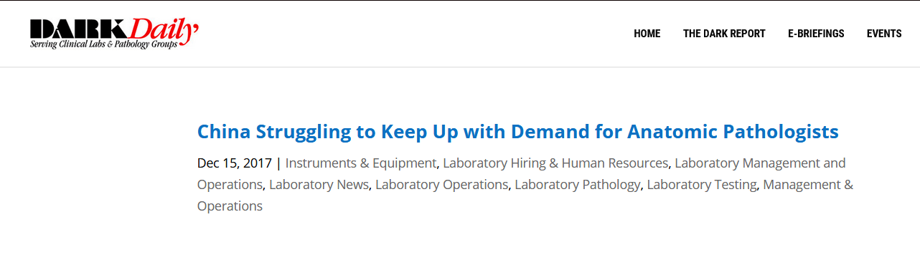
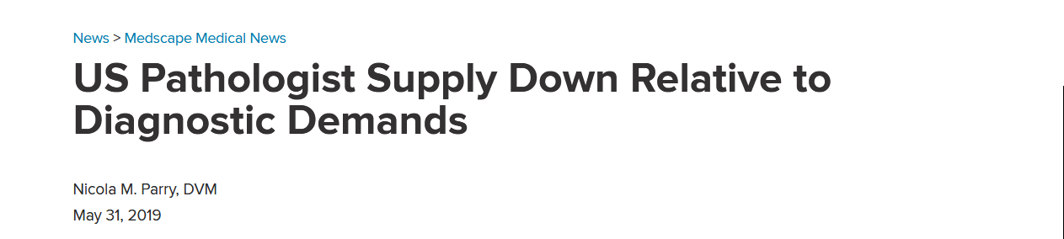
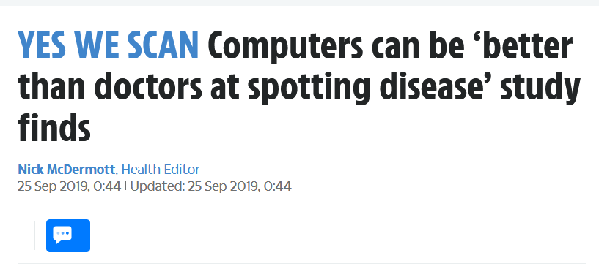
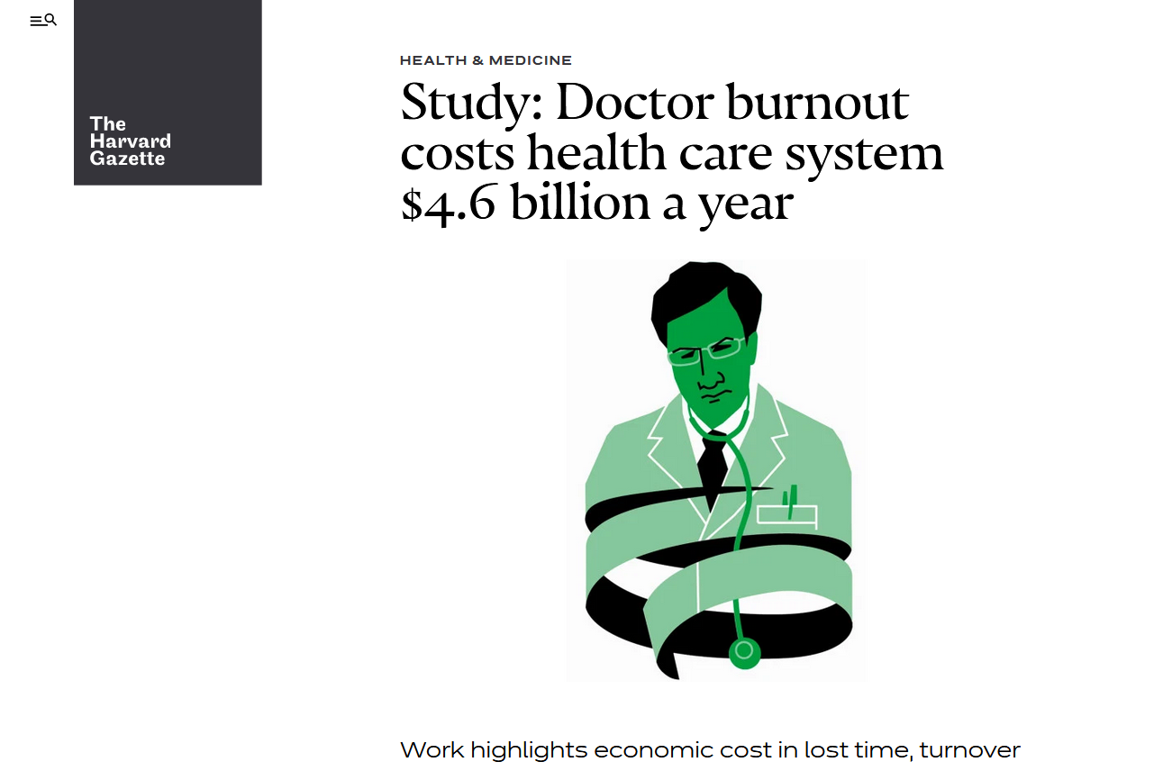
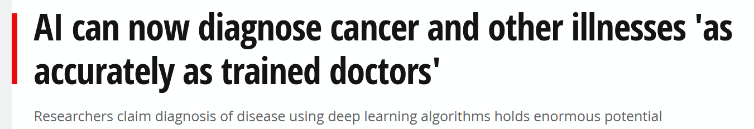

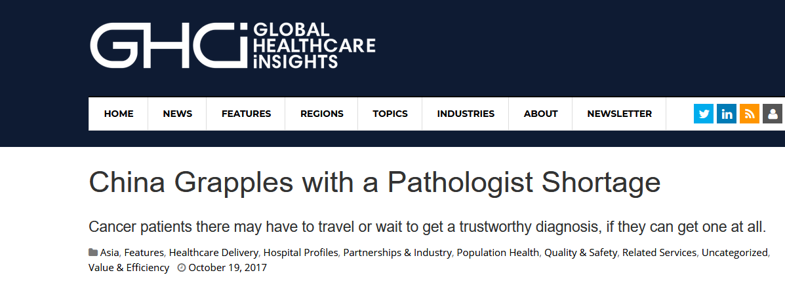
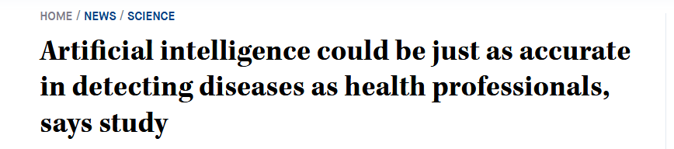
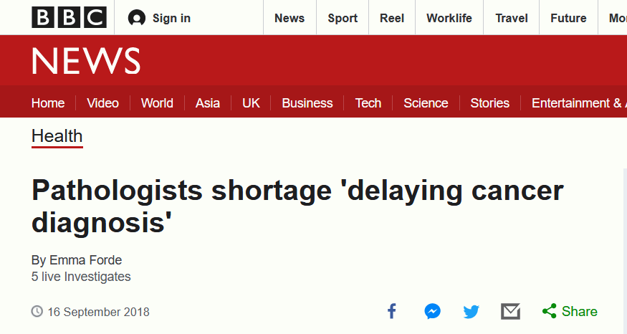
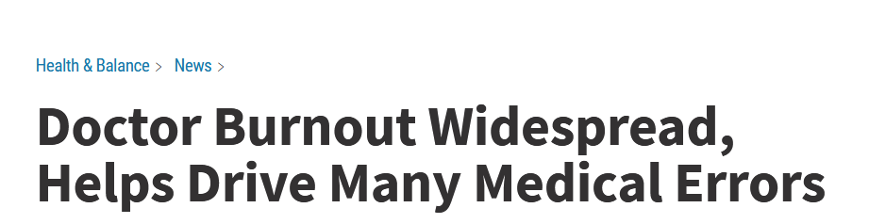
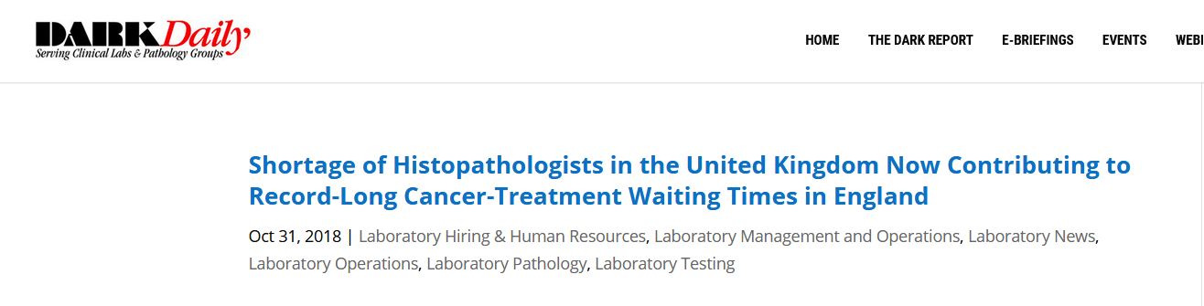
Why artificial intelligence ?
Image Source : Google Images

Slide 5
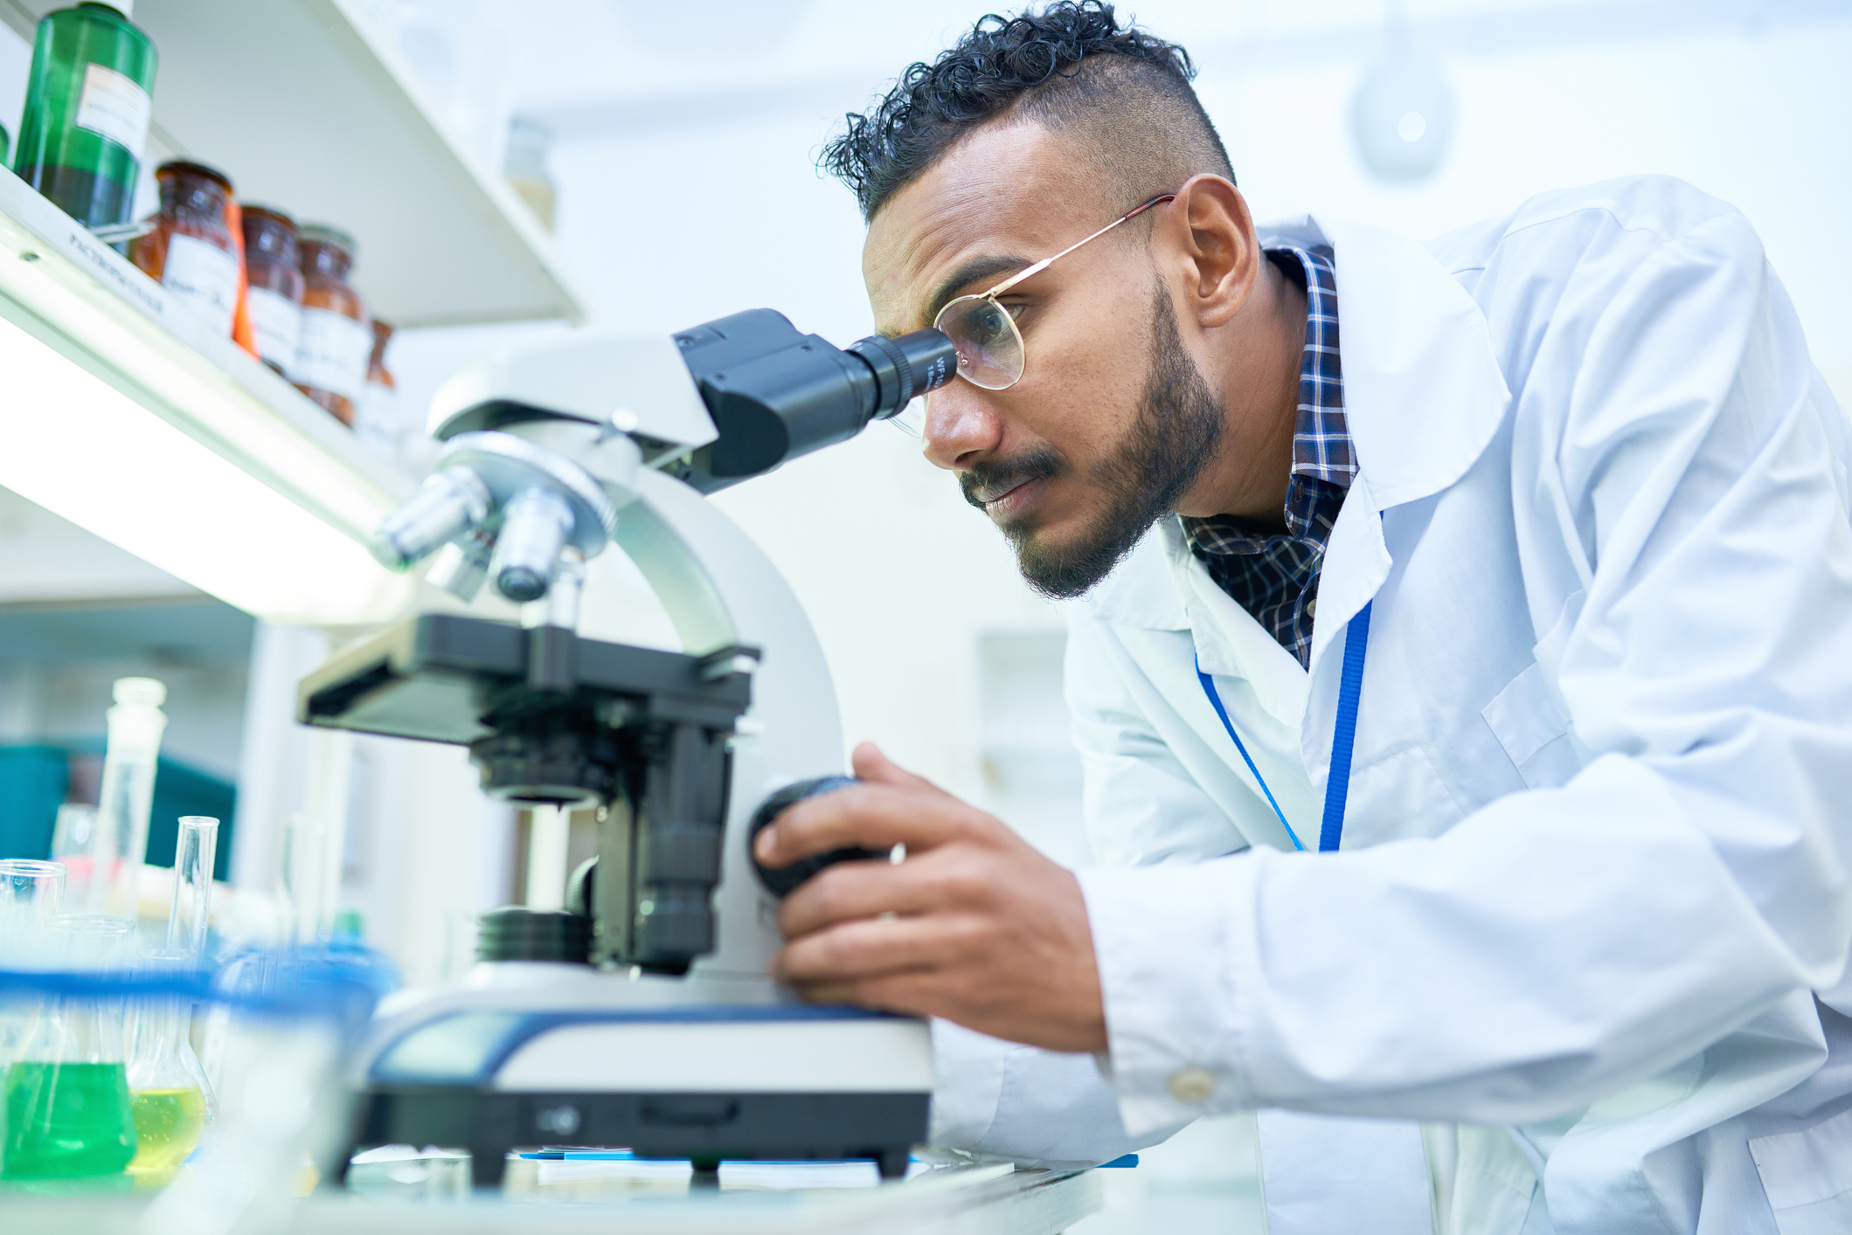
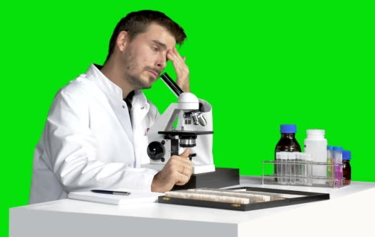

Why artificial intelligence ?
Lack of Skilled Pathologists
Pathologists to patient ratio : 1 : 1,30,000 (China - 2019) ; 2,200 : 121 crore (India - 2019)
17.53% decrease in number of US pathologists from 2007 to 2017
Human Error
Misinterpretation or erroneous conclusion due to physical and environmental factors
Inconsistency in interpretation of histological features
Efficiency and Accuracy
Average histopathologist takes hours to analyse a Whole Slide Image
All the information in a slide is not processed during analysis
Physical transportation can cause damage to slides and delay in diagnosis
Image Source : Google Images

Slide 6

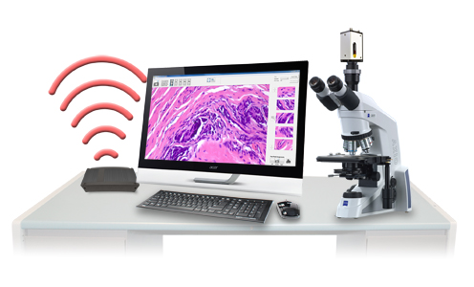

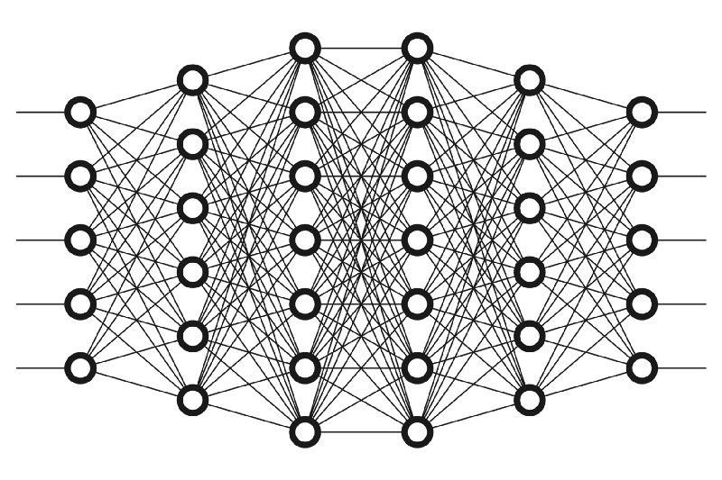

proposed methodology
Database
Verified images are added to database
Expert Pathologist
Improve AI using
Updated database
2.Laboratory - Conversion of tissues to WSI
AI Model
LOW
Confidence
WSI
HIGH
Final Prediction
1.Hospital
3.Server
Image Source : Google Images

Slide 7
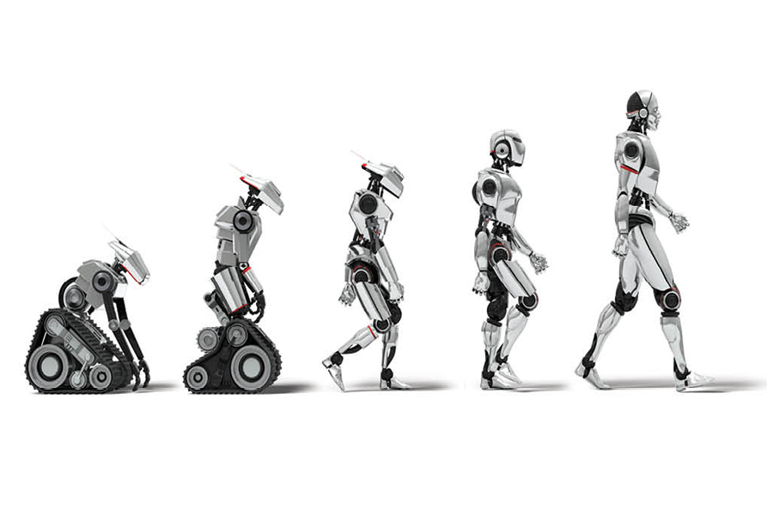
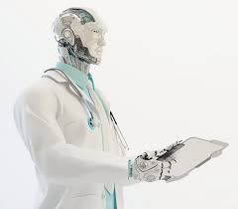
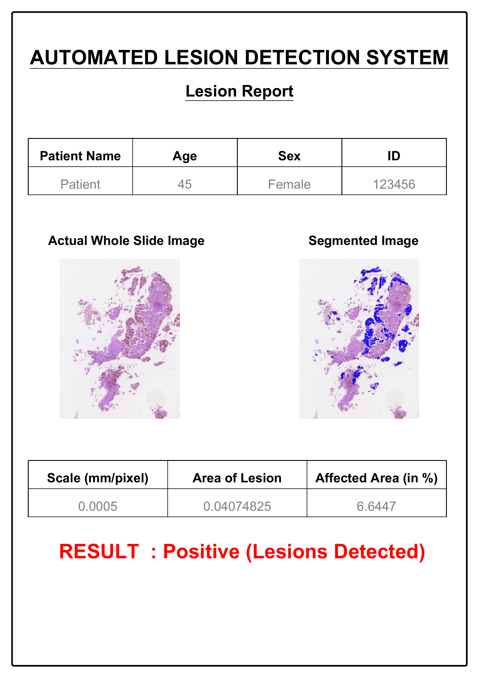
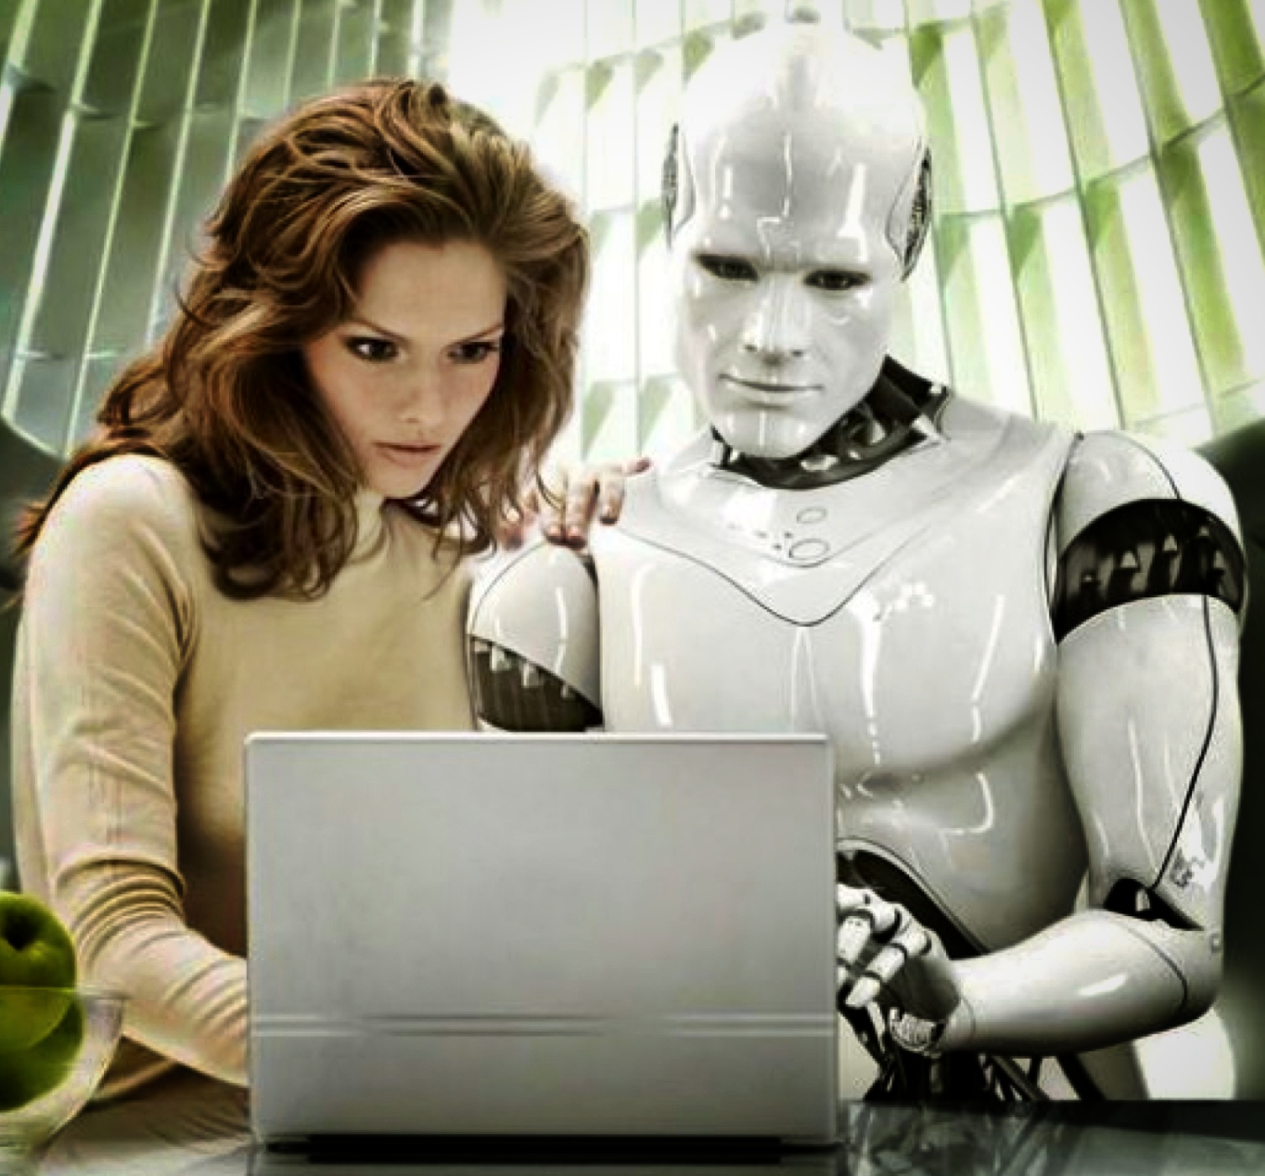
Features
Uncertainty Prediction
Self – Improving Model
To obtain the confidence of prediction made by the network
With the ever increasing amount of data collected and the extensive variations in tissue patterns learnt, the AI model is expected to be self sufficient and robust
Epistemic Uncertainty
Due to model uncertainty
Test Time Dropout
Aleatoric Uncertainty
Due to noise in test image
Test Time Augmentation
Optional Expert Consultation
Report Generation Pipeline
Limited data in the initial stage affects model accuracy
Lower confidence predictions are sent for expert pathologist verification
Verified data used to expand database
Automated creation of report similar to those provided by pathologists
Computer Vision (CV) techniques for extracting shape and geometry of detected lesions

Slide 8
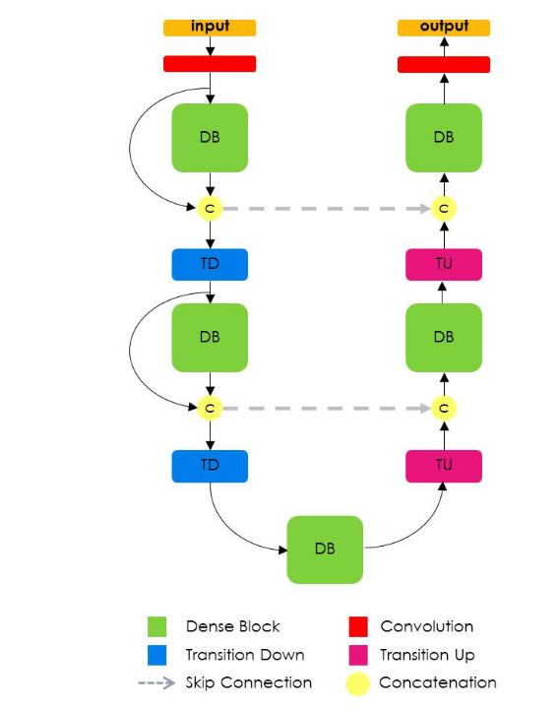
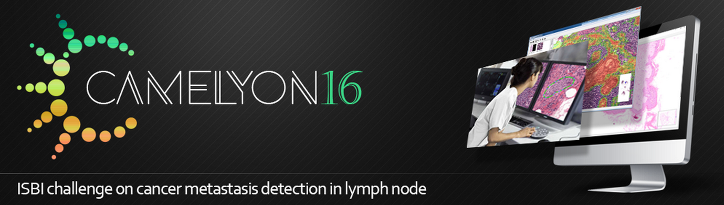

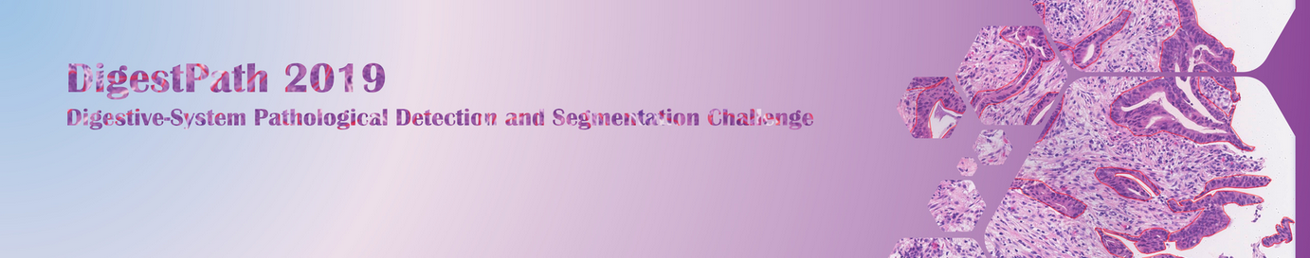
Overview of AI model
Fully convolutional DenseNet
Sample Images
Datasets
Deep Learning Techniques
Patch Sampling
Transfer Learning
CAMELYON - Contains lymph node sections
Data Augmentation
Weighted Sampling
DigestPath 2019 - Contains colonoscopy tissue sections
Network Architecture
Image Sources : https://digestpath2019.grand-challenge.org/ ; https://camelyon16.grand-challenge.org/Data/ ; https://camelyon17.grand-challenge.org/Data/; https://arxiv.org/abs/1611.09326

Slide 9
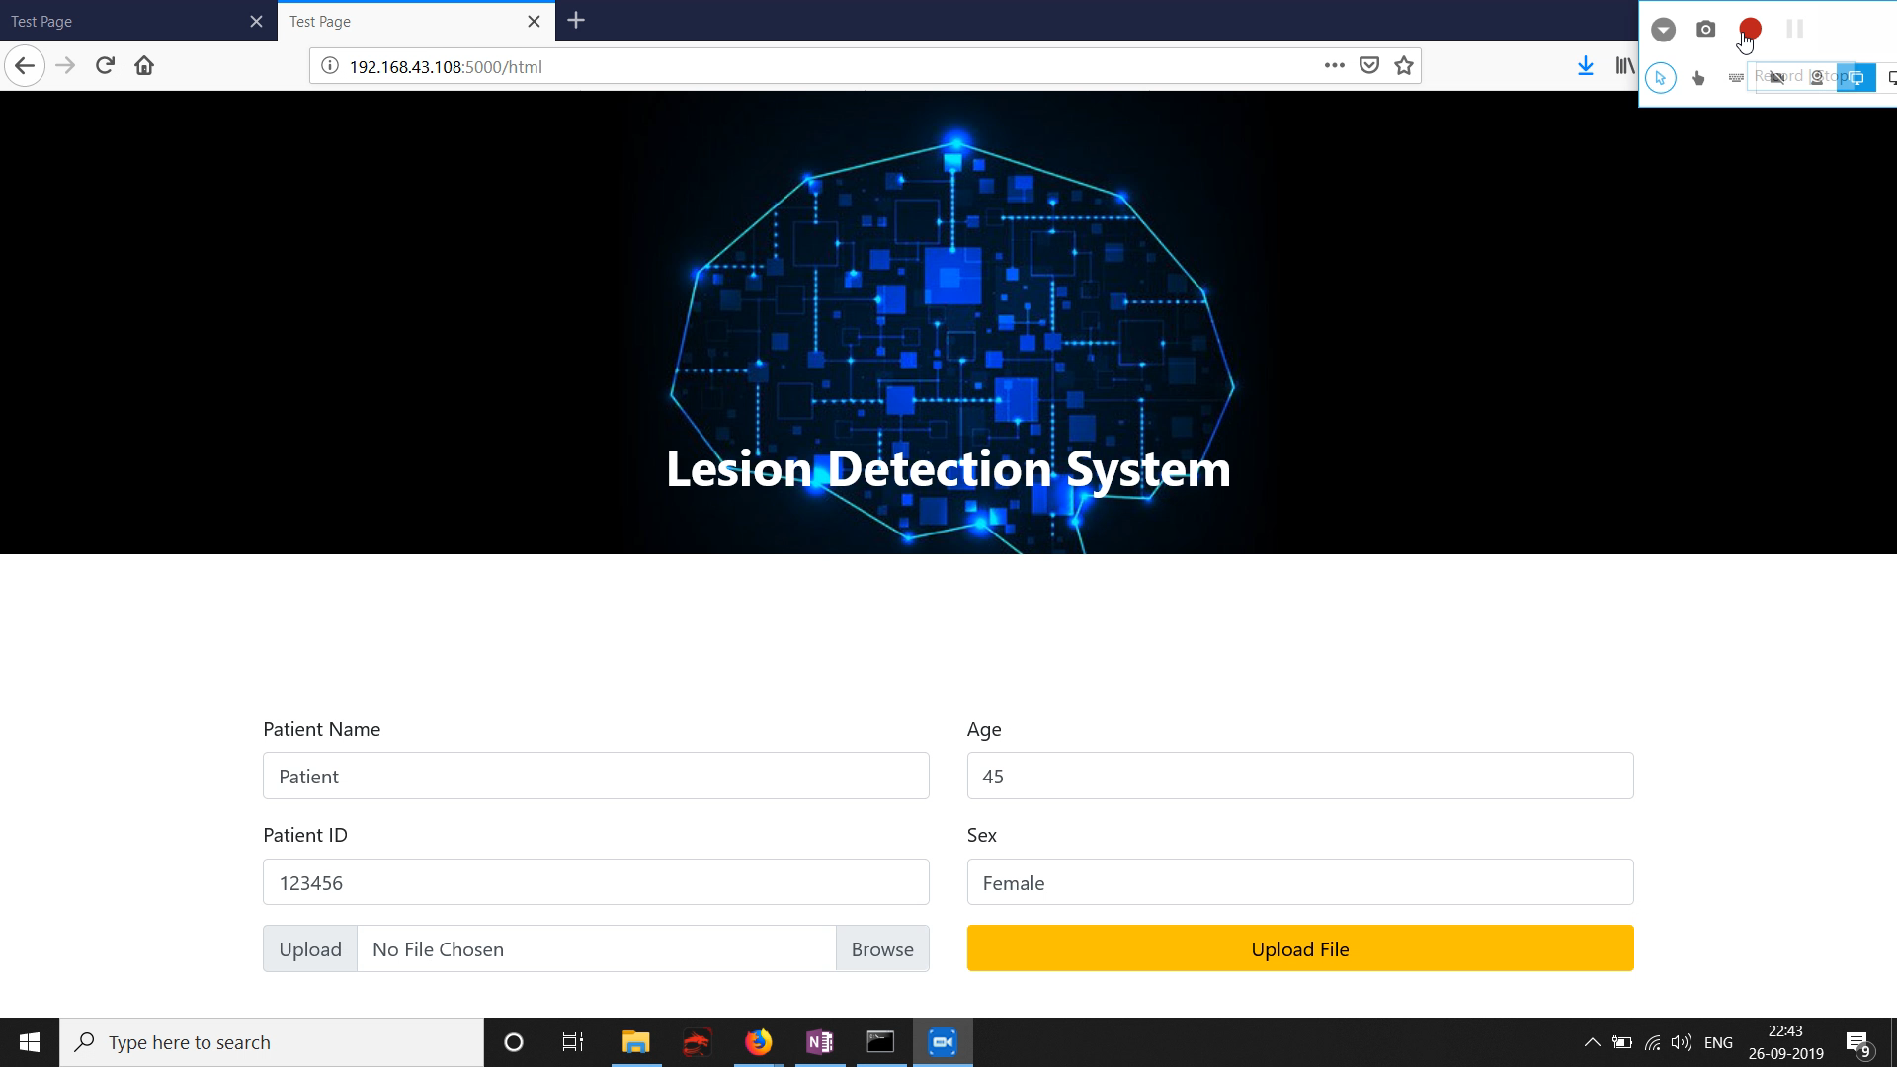

Slide 10
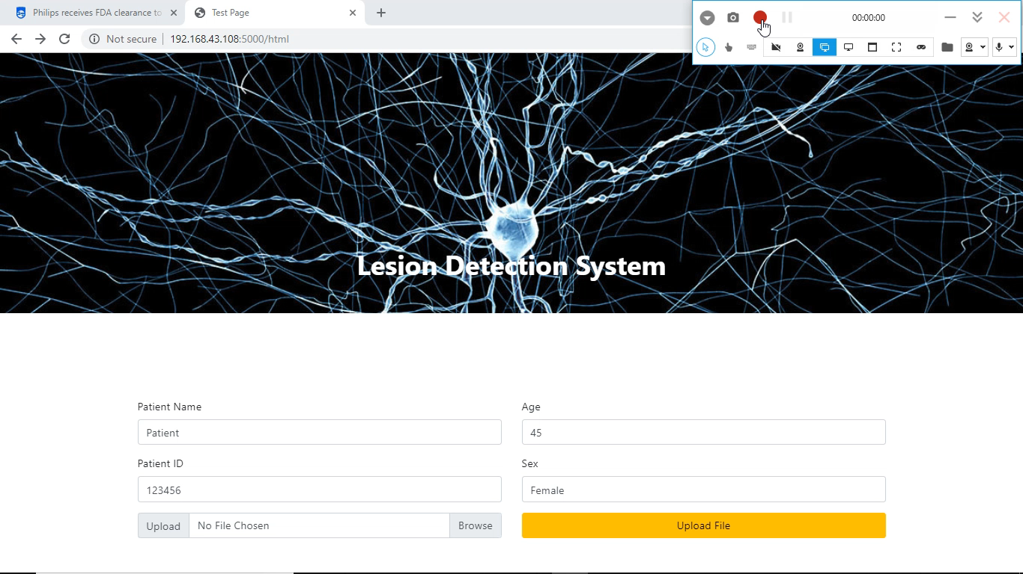
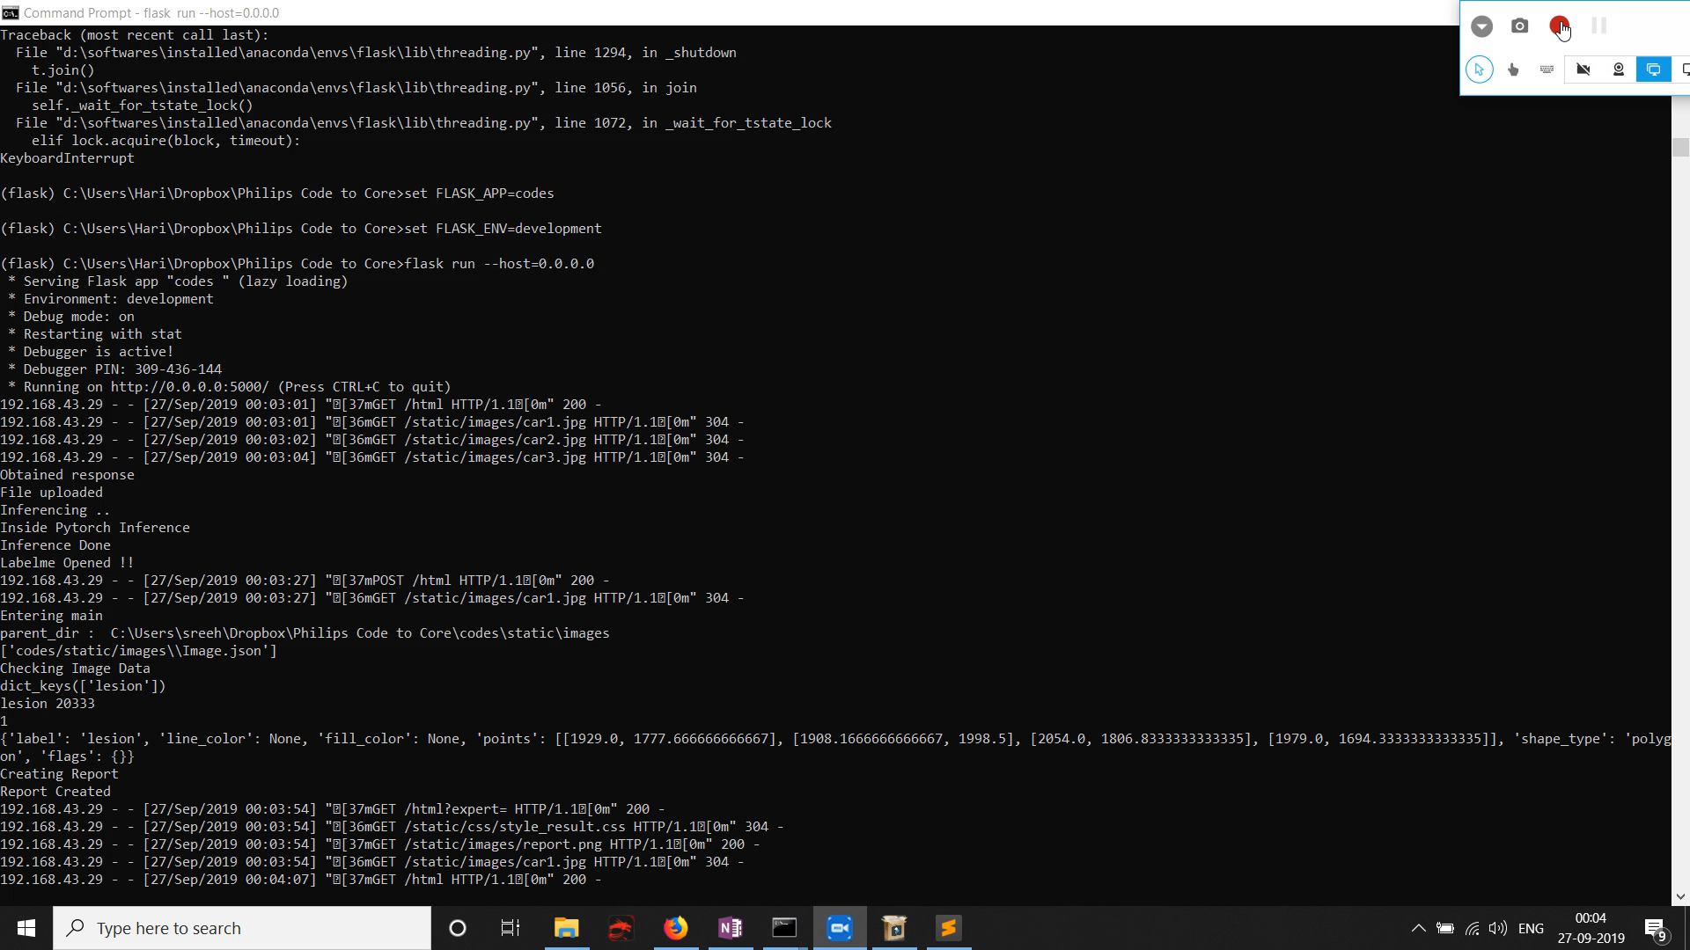
Expert Pathologist Verification

Slide 11
Thank you !! jjjj

